Slide 1
PHOTO UPLOAD

Slide 2
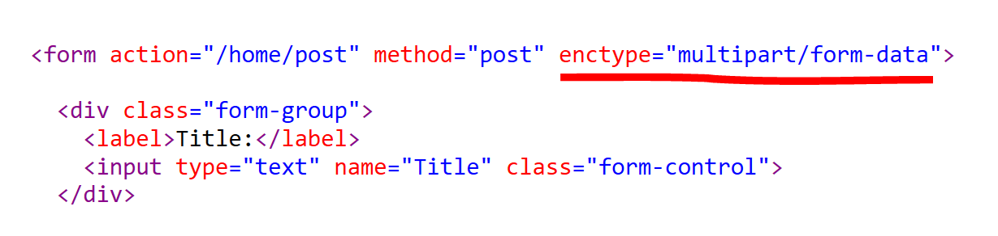
enctype="multipart/form-data"

Slide 3
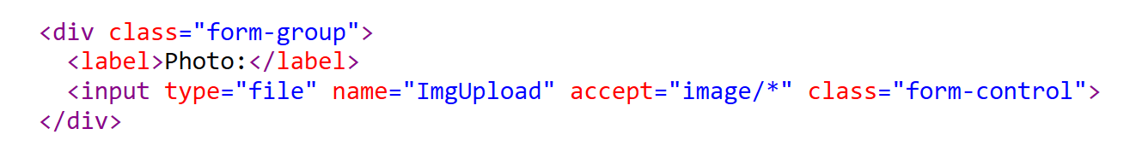
<input type="file">

Slide 4
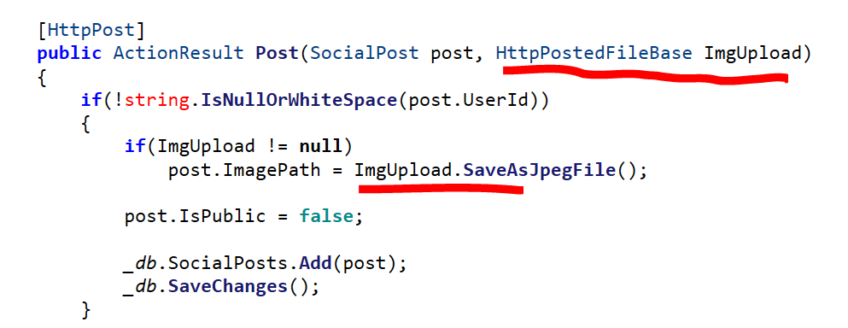
HttpPostedFileBase ImgUpload

Slide 5
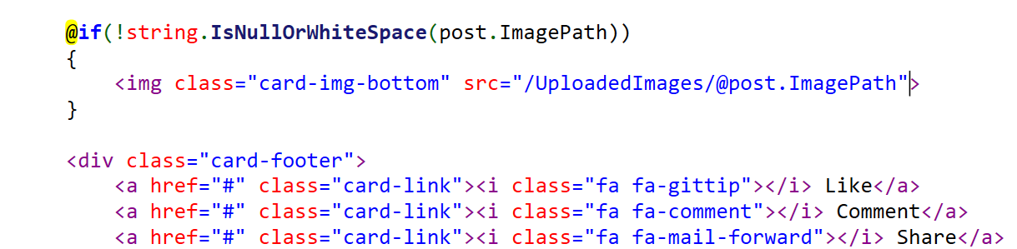
img src=""

